Slide 1


Swiggy Data Analysis Sales Dashboard
PREPARED BY
ROLE
Aditya Vishwakarma
Aspiring Data/Business Analyst
Converted Raw Data into An Interactive Dashboard & Extracted Meaningful Insights

Slide 2


Roadmap
Agenda & Project Milestones
Foundation & Setup
Logic & Visualization
Understanding the food-tech business case, evaluating raw CSV transactional logs, and structuring Excel data sheets.
Implementing advanced formula bypasses (OFFSET), dynamic charts, interactive slicer clusters, and reporting metrics.
Covers dynamic table normalization and calculated feature transformations.
Concludes with key regional takeaways and portfolio recommendations.

Slide 3
Project Catalyst
Strategic Problem & Goals
The Challenge
Our Core Project Goals
High Data Volume: Swiggy processes millions of transactions daily across multiple states and menus.
Unified KPI Views: Display 5+ key metrics (Sales, Orders, Ratings) instantly.
Operational Gaps: Siloed databases hid critical information about peak order timings and low-performing regions.
Visual Granularity: Build 6+ interactive visuals to deep-dive into sales segments.
Immediate Needs: Decision-makers required a lightweight, zero-overhead analytical sandbox to map trends.
Responsive Filtering: Create a polished interface with linked slicers.

Slide 4

Source Data
Dataset Under the Microscope
Field Name | Target Scope / Content | Sample Structural Record
State / City | Regional demographics of the delivery area | Karnataka / Bengaluru
Order Date | Temporal marker for tracking seasonality | 12-05-2025
Restaurant / Dish | Merchant identifier and item details | KFC / Hot & Crispy Chicken
Food Type | Dietary classification (essential demographic segment) | Veg / Non-Veg
Price / Rating / Rating Count | Product transaction values, scores, and review density | ₹299.00 / 4.33 Stars / 0.08 M
Data Validation Reference: Screenshot 2026-06-18 141224.png

Slide 5



ETL Phase
Data Preparation (ETL Process)
1. CSV Integration
2. Structured Table
3. Dynamic Scaling
Imported raw transactional logs cleanly into standard Excel grids to enable parsing.
Converted range formatting via Ctrl + T shortcut, defining structured references as "Swiggy_Data".
Ensured pivot sheets and charts scale instantly when new transaction rows are added.

Slide 6

Transformation
Data Transformation Formulas
Generated custom columns within the raw table to support deep-dive seasonality checks:
Target Column | Specific Excel Formula Utilized | Strategic Business Value
Month | =TEXT(Order_Date, "mmm") | Tracks monthly revenue spikes and promotional cycles.
Day | =TEXT(Order_Date, "ddd") | Identifies weekday vs weekend sales volume splits.
Quarter | ="Q"&ROUNDUP(MONTH(Order_Date)/3,0) | Aggregates operational trends into quarterly board reviews.

Slide 7
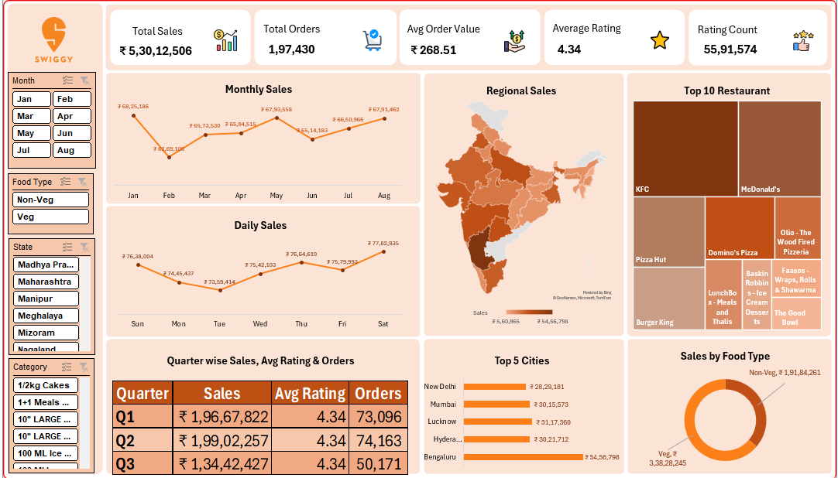
KPI Scope
Analytical Focus: KPI Problem Statements
Total Sales: Overall revenue generated from food orders across all restaurants.
Total Orders: Total number of customer orders received.
Average Order Value: Average revenue earned per order.
Average Rating: Average customer satisfaction rating across all restaurants.
Rating Count: Total number of customer reviews and ratings received.

Slide 8

Metrics
KPI Architecture Design
Target KPI Card | Source Column | Aggregation Logic | Business Value
Total Sales | Price | SUM | Tracks overall operational revenue (Gross Transaction Value).
Total Orders | State / Order ID | COUNT | Monitors total volume scale and logistics load.
Average Order Value | Price | AVERAGE | Tracks spending habits and cart size fluctuations.
Avg Customer Rating | Rating | AVERAGE | Measures overall platform and delivery quality levels.
Analytical Architecture Reference: Screenshot 2026-06-18 140901.png

Slide 9

Visual Story
Analytical Focus: Chart Problem Statements
Chart Category | Problem Statement & Analytical Focus | Dashboard Visual
Monthly Sales | Shows monthly sales performance and trend analysis. | Dynamic Line Chart
Daily Sales | Highlights day-wise sales fluctuations across the week. | Column Chart
Sales by Food Type | Compares revenue contribution between Veg and Non-Veg categories. | Balanced Donut Chart
Top 10 Restaurant | Identifies restaurants generating the highest sales revenue. | Treemap Visualization
Regional Sales | Displays state-wise revenue distribution using map visualization. | Dynamic India Map Chart
Quarter-wise Performance | Provides quarterly comparison of sales, ratings, and orders. | Performance Data Table
Top 5 Cities | Displays cities contributing the highest sales revenue. | Horizontal Bar Chart
Execution Reference: Screenshot 2026-06-18 141852.png & Screenshot 2026-06-18 141304.png

Slide 10

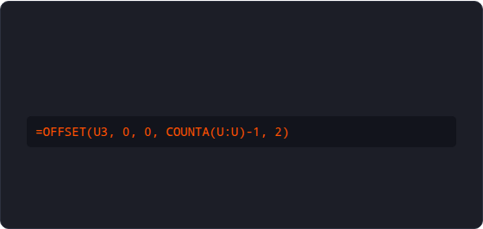
Advanced Excel
OFFSET Formula Logic
The Technical Limitation
The Dynamic Bypass
By default, Map Charts and Treemaps in Excel cannot connect directly to Pivot Tables.
Constructed a dynamic mirror range next to the Pivot Table using OFFSET and COUNTA:
This limitation blocks real-time dynamic updates when users click on slicer filters.
Ensures all charts update automatically when filters change, avoiding manual copy-pasting.

Slide 11




UX Strategy
Dashboard Layout Workflow
1. Canvas Prep
2. Wireframing
3. Alignment
4. Lock Assets
Created a "Dashboard" sheet with a dark theme background to give it a premium look.
Inserted custom rounded shapes to map out spots for Slicers, top KPIs, and primary charts.
Grouped layout containers cleanly, using cell links to map KPI values dynamically.
Exported aligned layouts as a flat background picture to prevent accidental adjustments.

Slide 12



Interactivity
Interactive Slicers UI
Multi-Field Filters
Visual Style
Grid Optimization
Added custom Slicers for **State, Month, Food Type, and Category** to give users complete control over the views.
Restyled the slicers with a dark charcoal and orange theme, matching Swiggy's brand identity.
Configured the Month slicer with a **2-column layout** to save valuable vertical sidebar space.

Slide 13


Under the Hood
Report Connections
The Synchronization Challenge
Exception Connection Logic
By default, Excel slicers only connect to the specific Pivot Table they were created from.
Mapped report connections across all target pivot components while applying exception logic:
This leaves other visuals disconnected, showing a fragmented performance view.
Exception 1: Excluded Month filters from the Monthly Sales Trend Line Chart (this keeps the monthly trend line from breaking into a single dot).
Exception 2: Excluded Food Type filters from the dietary preference Donut Chart.

Slide 14


Value Summary
Key Performance Takeaways
₹53M+
19.74M
₹268
4.34★
TOTAL PERIOD SALES
FULFILLMENTS
AVG ORDER VALUE
AVG CUSTOMER RATING
Insights: 1. **Temporal Trends:** Saturdays and Sundays see major surges, while weekdays (Mondays/Tuesdays) experience dips. 2. **Dietary split:** Veg items contribute **64%** of revenue, significantly outperforming Non-Veg (36%). 3. **Geographic focus:** Bengaluru leads sales, followed closely by Lucknow, Hyderabad, and Mumbai.
Regional Analysis Reference: Screenshot 2026-06-18 141852.png & Screenshot 2026-06-18 141304.png

Slide 15

Summary
Technical Stack Summary
Category | Specific Tools / Formulas | Strategic Application
Data Preparation | Structured Tables, Ctrl + T | Created dynamic reference ranges to handle 1.97M rows.
Transformation | TEXT(), MONTH(), ROUNDUP() | Engineered Day, Month, and Quarter dimensions.
Aggregations | Pivot Tables, Pivot Charts | Consolidated database parameters into clean visual summaries.
Dynamic Ranges | OFFSET(), COUNTA() | Bypassed pivot limits to feed data to Maps and Treemaps.
Interactivity | Slicers, Report Connections | Linked filters dynamically across the entire visual layout.

Slide 16
Retrospective
Key Learnings & Takeaways
Preparation is 70% of the Work: Unstructured databases require thorough cleaning before you can build reliable, accurate metrics.
Scalability Matters: Using native Excel features like Tables and Pivot Models allows you to analyze massive datasets seamlessly without performance slowdowns.
User Experience Drives Adoption: Designing simple interactive filters (like slicers) makes data accessible to business leaders, reducing friction.
Creative Troubleshooting: When standard tools have limits (like direct Pivot Map charts), using dynamic bypasses like the OFFSET formula solves the problem.

Slide 17


Scaling Up
Future Expansion Scope
Delivery Logistics
Discount Modeling
Power BI Migration
Analyze dispatch logs and average customer wait times to optimize rider allocation during peak weekend hours.
Track the impact of promo campaigns on weekday orders (especially Monday and Tuesday) to help stabilize demand.
Migrate the spreadsheet architecture into a cloud-hosted Power BI dashboard for real-time automated updates.

Slide 18

Thank You!
Let's translate complex database parameters into clear, actionable business stories together.
linkedin.com/in/adityaanalyst09
LET'S CONNECT

